Slide 1
Machine Learning with Python
Information Engineering, KSU
Jason

Slide 2
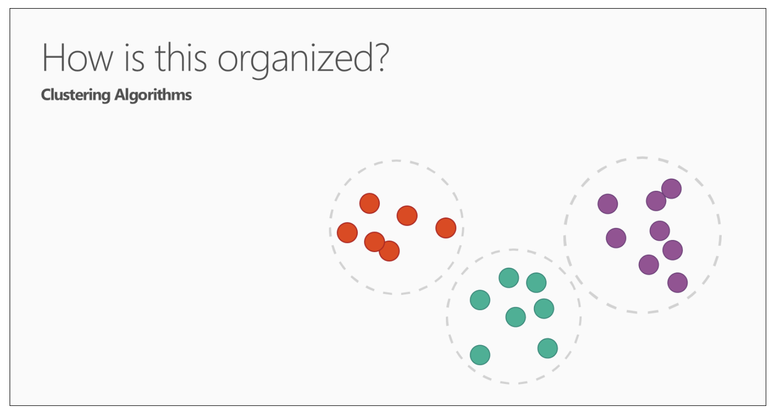
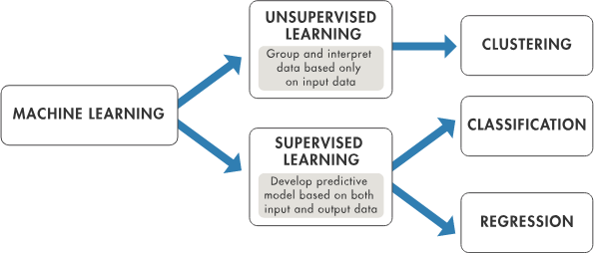
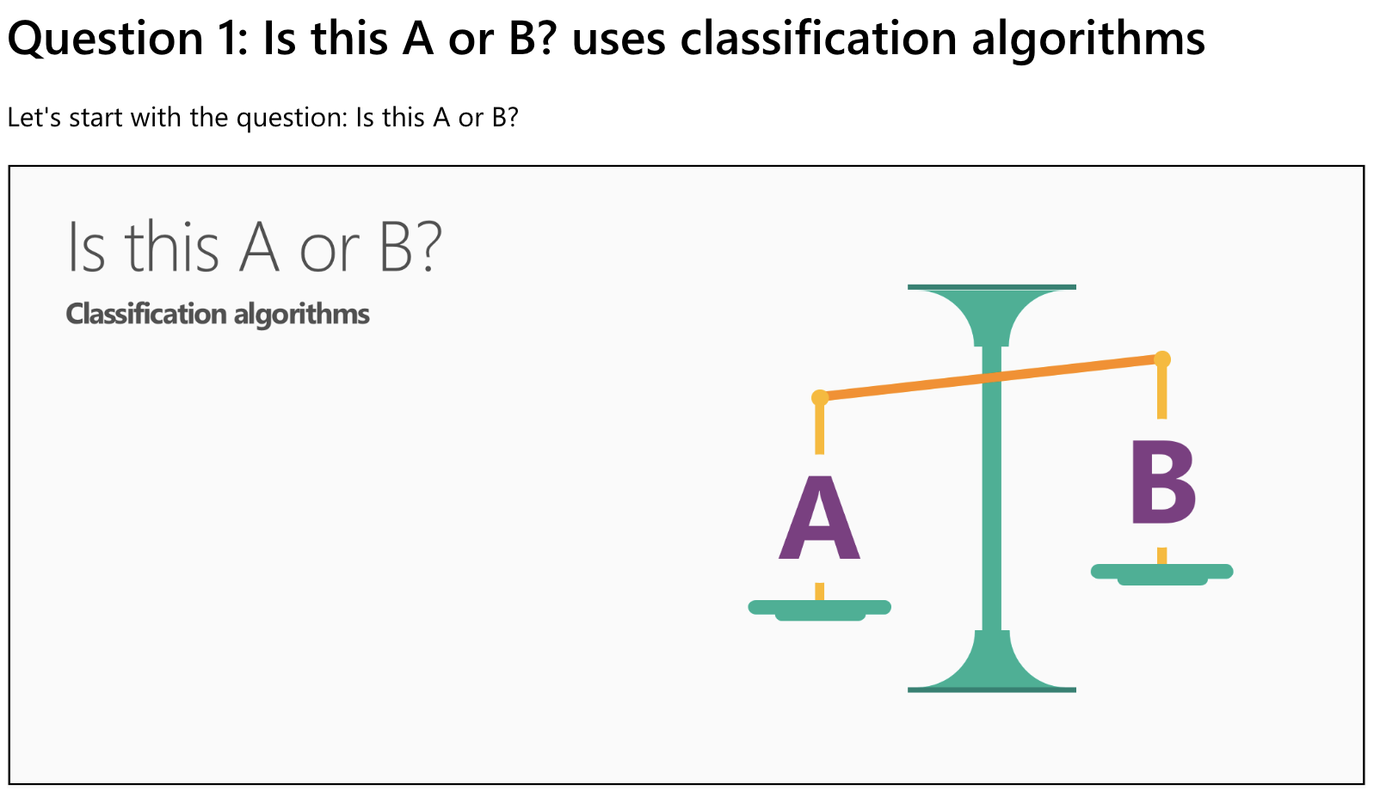
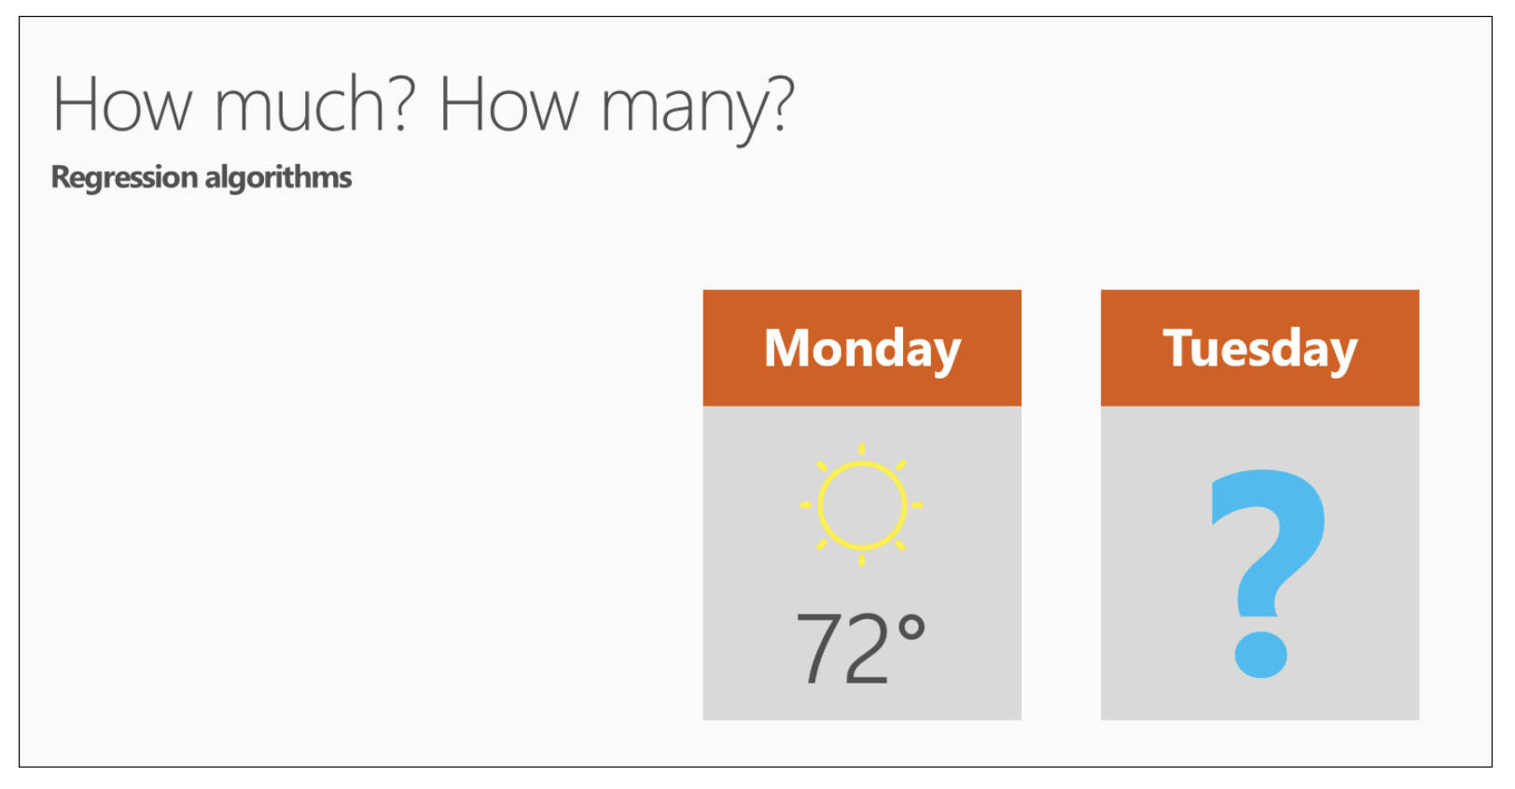
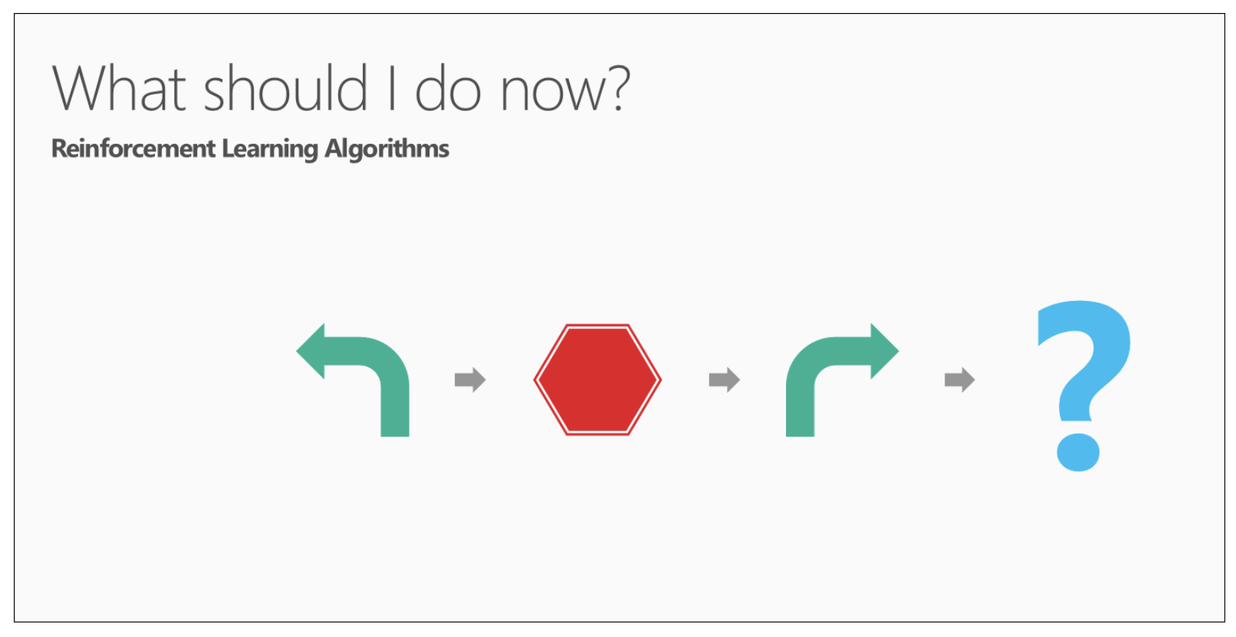
Step 0. Brief Overview of ML Process You Need to Know
A machine learning project may not be linear, but it has a number of well known steps:
Define Problem.
Prepare Data.
Evaluate Algorithms.
Improve Results.
Present Results.
To look for patterns, various algorithms are used, which are divided into three groups:
Unsupervised learning
Supervised learning
Reinforce learning
Reinforcement
Learning

Slide 3
Unsupervised Learning
Machine receives only a set of input data. Thereafter, the machine is up to determine the relationship between the entered data and any other hypothetical data.
Unlike supervised learning, where the machine is provided with some verification data for learning, independent Unsupervised learning implies that the computer itself will find patterns and relationships between different data sets.
Unsupervised learning can be further divided into clustering and association.
Common examples of clustering questions are:
Which viewers like the same types of movies?
Which printer models fail the same way?

Slide 4
Supervised Learning
Supervised learning implies the computer ability to recognize elements based on the provided samples. The computer studies it and develops the ability to recognize new data based on this data. For example, you can train your computer to filter spam messages based on previously received information.
Some Supervised learning algorithms include:
Decision trees
Support-vector machine
Naive Bayes classifier
k-nearest neighbors
linear regression

Slide 5
Machine Learning in Python: Step-By-Step
Here is an overview of what we are going to cover:
Installing the Python, SciPy platform, etc. a list of libraries for running machine learning.
Loading the dataset.
Summarizing the dataset.
Visualizing the dataset.
Evaluating some algorithms.
Making some predictions.

Slide 6
Hello World of Machine Learning: classification of iris flowers
The best small project to start with on a new tool is the classification of iris flowers (e.g. the iris dataset).
This is a good project because it is so well understood.
Attributes are numeric so you have to figure out how to load and handle data.
It is a classification problem, allowing you to practice with perhaps an easier type of supervised learning algorithm.
It is a multi-class classification problem (multi-nominal) that may require some specialized handling.
It only has 4 attributes and 150 rows, meaning it is small and easily fits into memory (and a screen or A4 page).
All of the numeric attributes are in the same units and the same scale, not requiring any special scaling or transforms to get started.

Slide 7
1. Downloading, Installing and Starting Python SciPy
1.1 Install SciPy Libraries
This tutorial assumes Python version 2.7 or 3.5+.
There are 5 key libraries that you will need to install. Below is a list of the Python SciPy libraries required for this tutorial:
scipy
numpy
matplotlib
pandas
sklearn
Mac:
Install brew on mac:
XCode Command Line Tools installed on your Mac: $ xcode-select --install
$ ruby -e "$(curl -fsSL https://raw.githubusercontent.com/Homebrew/install/master/install)”
$ brew update
$ brew install python3
$ python3 -V
Install packages:
$ python3 -m pip install --user numpy scipy matplotlib ipython jupyter pandas sympy nose statsmodels scikit-learn

Slide 8
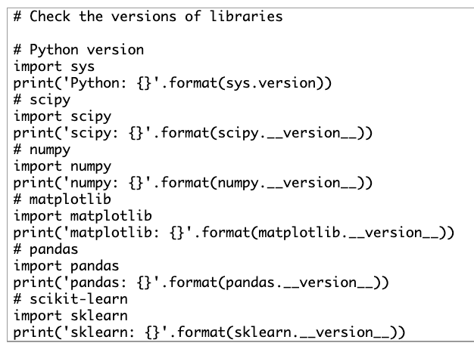
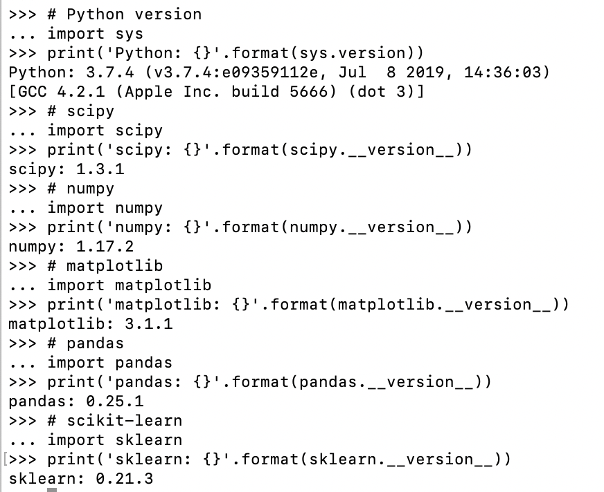
1.2 Start Python and Check Versions
Open a command line and start the python interpreter: python
Type or copy and paste the following script:

Slide 9
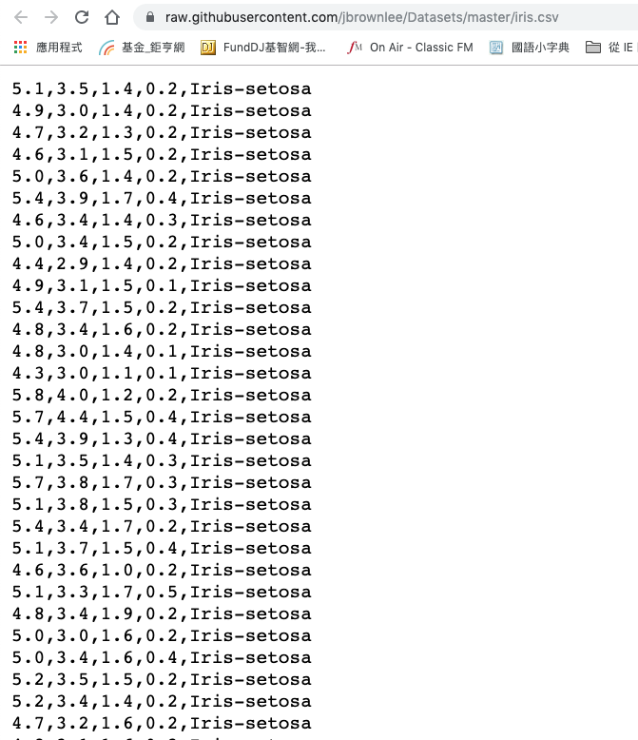
2. Load The Data: iris flowers
The best small project to start with on a new tool is the classification of iris flowers
We are going to use the iris flowers dataset. This dataset is famous because it is used as the “hello world” dataset in machine learning and statistics by pretty much everyone.
The dataset contains 150 observations of iris flowers. There are four columns of measurements of the flowers in centimeters. The fifth column is the species of the flower observed. All observed flowers belong to one of three species.
You can learn more about this dataset on Wikipedia

Slide 10
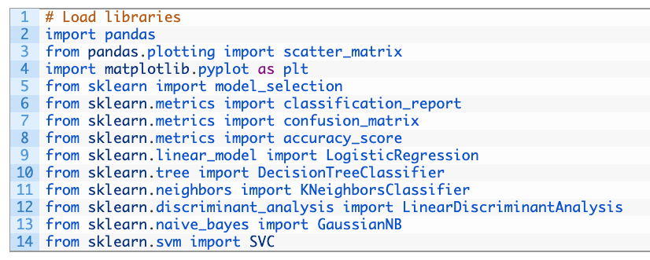
2.1 Import libraries
In this step we are going to load the iris data from CSV file URL.
First, let’s import all of the modules, functions and objects we are going to use in this tutorial.

Slide 11
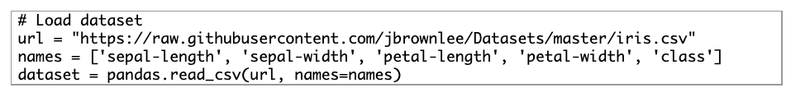
2.2 Load Dataset
We can load the data directly from the UCI Machine Learning repository.
We are using pandas to load the data. We will also use pandas next to explore the data both with descriptive statistics and data visualization.
If you do have network problems, you can download the iris.csv file into your working directory and load it using the same method, changing URL to the local file name.

Slide 12
3. Summarize the Dataset
In this step we are going to take a look at the data a few different ways:
Dimensions of the dataset.
Peek at the data itself.
Statistical summary of all attributes.
Breakdown of the data by the class variable.

Slide 13
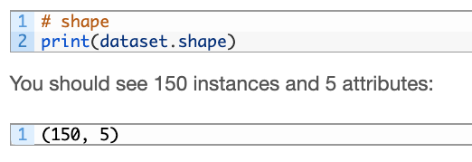
3.1 Dimensions of Dataset
get a quick idea of how many instances (rows) and how many attributes (columns) the data contains with the shape property.

Slide 14
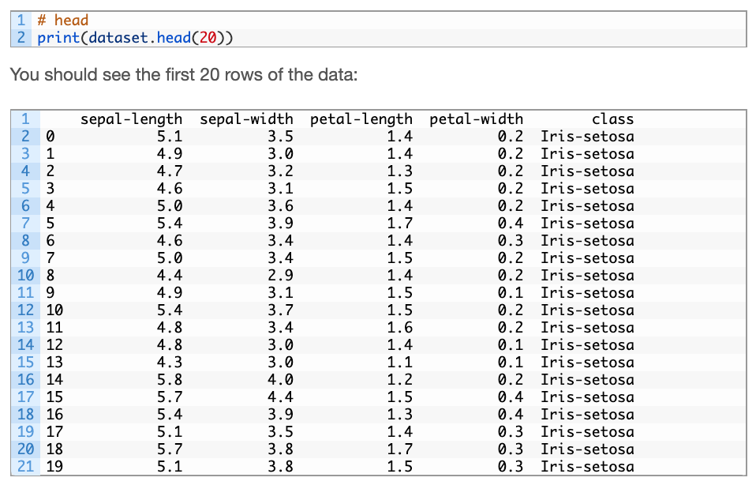
3.2 Peek at the Data

Slide 15
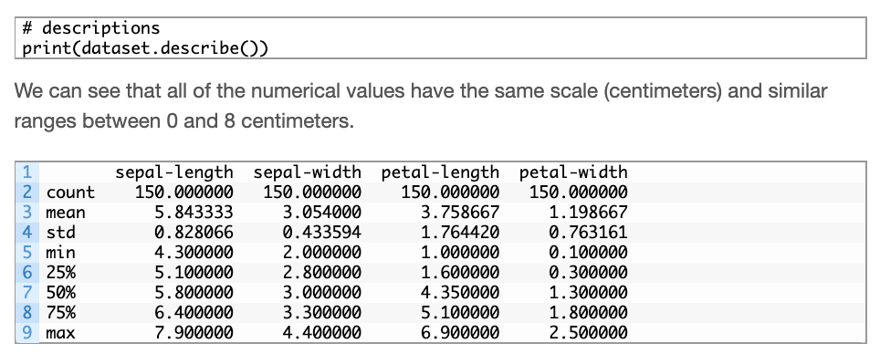
3.3 Statistical Summary
Now we can take a look at a summary of each attribute.
This includes the count, mean, the min and max values as well as some percentiles.

Slide 16
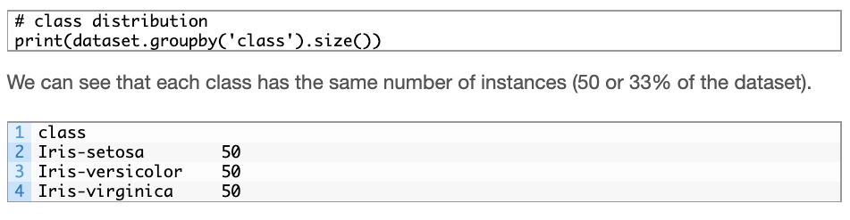
3.4 Class Distribution
Let’s now take a look at the number of instances (rows) that belong to each class. We can view this as an absolute count.

Slide 17
4. Data Visualization
We are going to look at two types of plots:
Univariate plots to better understand each attribute.
Multivariate plots to better understand the relationships between attributes.

Slide 18
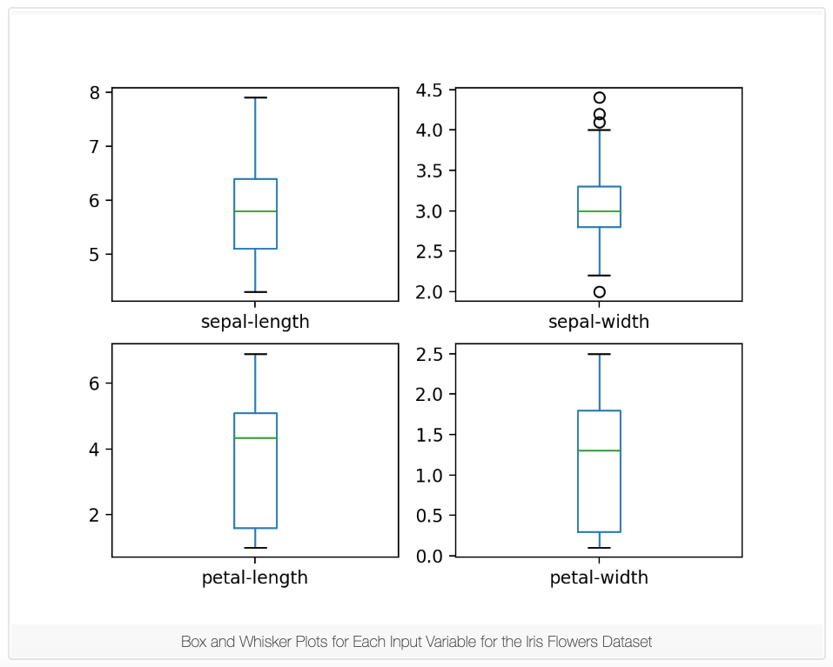
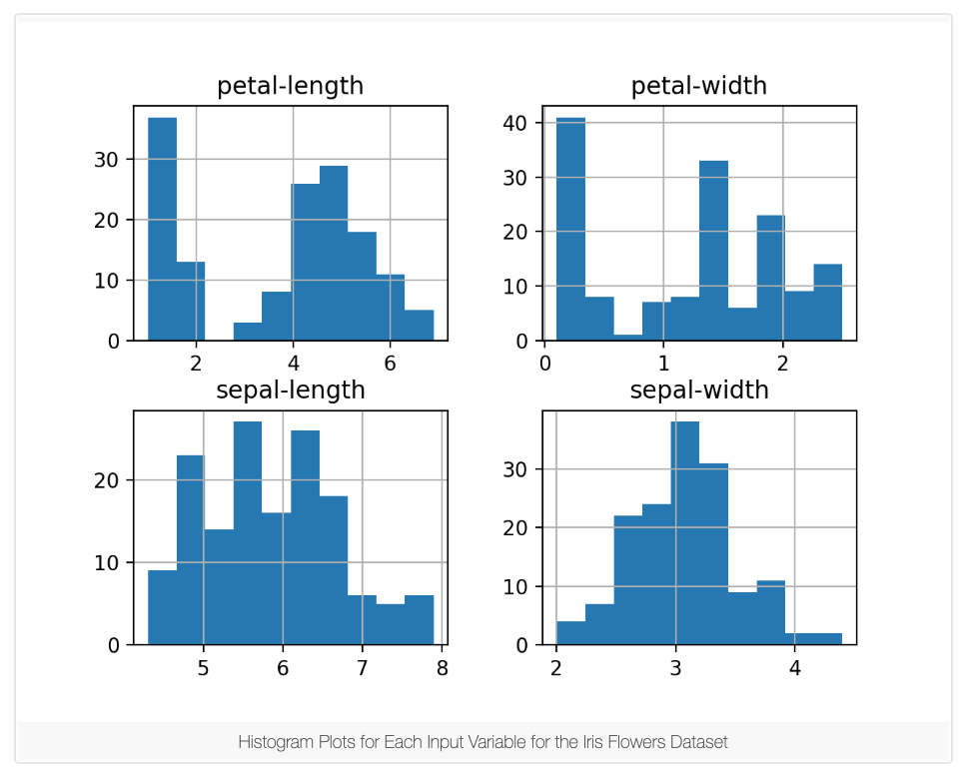


4.1 Univariate Plots
Given that the input variables are numeric, we can create box and whisker plots of each.
We can also create a histogram of each input variable to get an idea of the distribution.
Two of the input variables have a Gaussian distribution. This is useful to note as we can use algorithms that can exploit this assumption.
Gaussian distribution

Slide 19
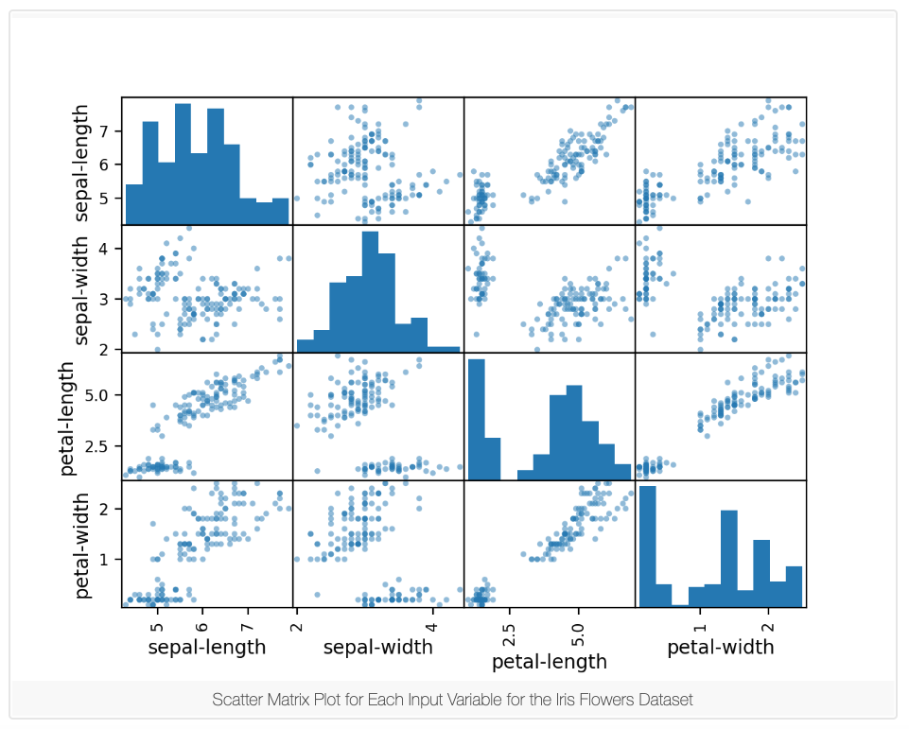

4.2 Multivariate Plots
look at the interactions between the variables.
First, let’s look at scatterplots of all pairs of attributes. This can be helpful to spot structured relationships between input variables.
Note the diagonal grouping of some pairs of attributes. This suggests a high correlation and a predictable relationship.
high correlation

Slide 20
5. Evaluate Some Algorithms
it is time to create some models of the data and estimate their accuracy on unseen data.
Here is what we are going to cover in this step:
Separate out a validation dataset.
Set-up the test harness to use 10-fold cross validation.
Build 5 different models to predict species from flower measurements
Select the best model.

Slide 21
5.1 Create a Validation Dataset
We need to know that the model we created is any good.
Later, we will use statistical methods to estimate the accuracy of the models that we create on unseen data. We also want a more concrete estimate of the accuracy of the best model on unseen data by evaluating it on actual unseen data.
That is, we are going to hold back some data that the algorithms will not get to see and we will use this data to get a second and independent idea of how accurate the best model might actually be.
We will split the loaded dataset into two, 80% of which we will use to train our models and 20% that we will hold back as a validation dataset.

Slide 22
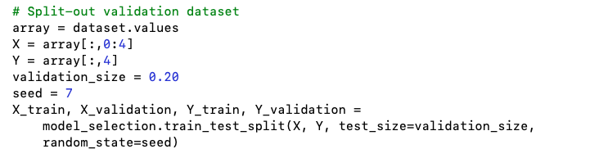
You now have training data in the X_train and Y_train for preparing models and a X_validation and Y_validation sets that we can use later.
Notice that we used a python slice to select the columns in the NumPy array. If this is new to you, you might want to check-out this post:
How to Index, Slice and Reshape NumPy Arrays for Machine Learning in Python

Slide 23

5.2 Test Harness
We will use 10-fold cross validation to estimate accuracy.
This will split our dataset into 10 parts, train on 9 and test on 1 and repeat for all combinations of train-test splits.
The specific random seed does not matter, learn more about pseudorandom number generators here:
Introduction to Random Number Generators for Machine Learning in Python
We are using the metric of ‘accuracy‘ to evaluate models. This is a ratio of the number of correctly predicted instances in divided by the total number of instances in the dataset multiplied by 100 to give a percentage (e.g. 95% accurate). We will be using the scoring variable when we run build and evaluate each model next.

Slide 24
5.3 Build Models
We don’t know which algorithms would be good on this problem or what configurations to use. We get an idea from the plots that some of the classes are partially linearly separable in some dimensions, so we are expecting generally good results.
Let’s evaluate 6 different algorithms:
Logistic Regression (LR)
Linear Discriminant Analysis (LDA)
K-Nearest Neighbors (KNN).
Classification and Regression Trees (CART).
Gaussian Naive Bayes (NB).
Support Vector Machines (SVM).
This is a good mixture of simple linear (LR and LDA), nonlinear (KNN, CART, NB and SVM) algorithms. We reset the random number seed before each run to ensure that the evaluation of each algorithm is performed using exactly the same data splits. It ensures the results are directly comparable.

Slide 25
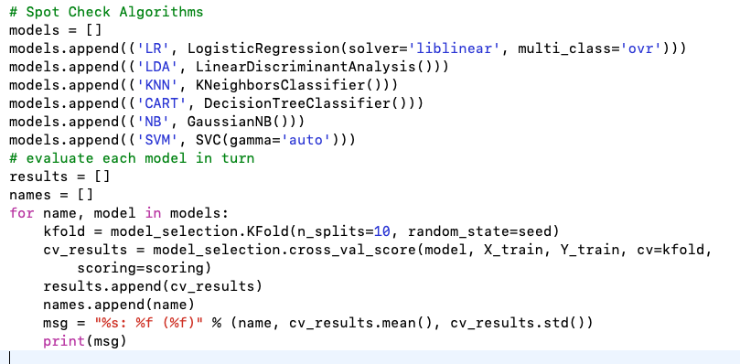

Slide 26
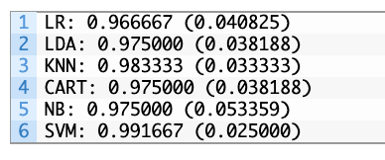
5.4 Select Best Model
We now have 6 models and accuracy estimations for each. We need to compare the models to each other and select the most accurate.
Running the example above, we get the following raw results:

Slide 27
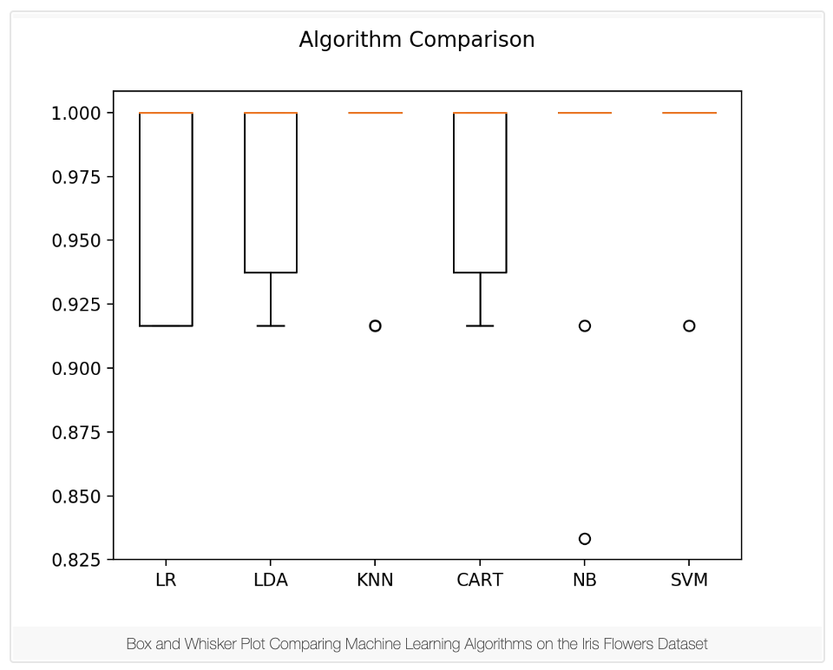
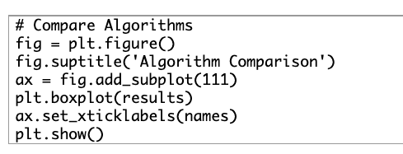
In this case, we can see that it looks like Support Vector Machines (SVM) has the largest estimated accuracy score.
We can also create a plot of the model evaluation results and compare the spread and the mean accuracy of each model. There is a population of accuracy measures for each algorithm because each algorithm was evaluated 10 times (10 fold cross validation).
You can see that the box and whisker plots are squashed at the top of the range, with many samples achieving 100% accuracy.

Slide 28
6. Make Predictions
The KNN algorithm is very simple and was an accurate model based on our tests. Now we want to get an idea of the accuracy of the model on our validation set.
This will give us an independent final check on the accuracy of the best model. It is valuable to keep a validation set just in case you made a slip during training, such as overfitting to the training set or a data leak. Both will result in an overly optimistic result.
We can run the KNN model directly on the validation set and summarize the results as a final accuracy score, a confusion matrix and a classification report.

Slide 29
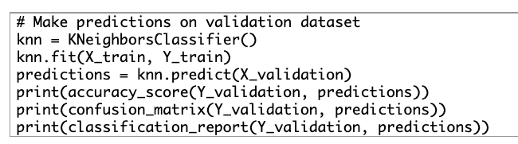
We can see that the accuracy is 0.9 or 90%. The confusion matrix provides an indication of the three errors made. Finally, the classification report provides a breakdown of each class by precision, recall, f1-score and support showing excellent results (granted the validation dataset was small).
You can learn more about how to make predictions and predict probabilities here:
How to Make Predictions with scikit-learn

